Slide 1

HOUSING: PRICE PREDICTION
09-07-2022
Internship - 27
Presented by: Dipak Someshwar

Slide 2
Acknowledgement
Data Science with ML
SME - Sapna Verma
Flip Robo Technology

Slide 3
What is HOUSING PRICE PREDICTION?
Houses are one of the necessary need of each and every person around the globe and therefore housing and real estate.
House price prediction can help the developer determine the selling price of a house and can help the customer to arrange the right time to purchase a house.
influence the price of a house which include physical conditions, concept and location. House Price prediction, is important to drive Real Estate efficiency. As earlier, House prices were determined by calculating the acquiring and selling price in a locality.

Slide 4
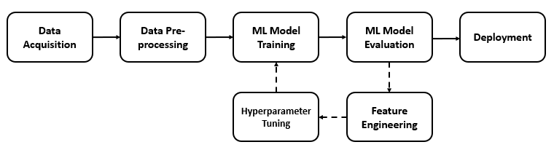
HOUSING: PRICE PREDICTION Diagram:

Slide 5
Visualization of HOUSING PRICE PREDICTION

Slide 6
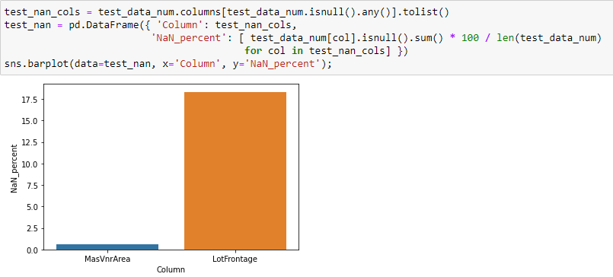
Graphs:
This barplot gives numbers of counts and showing that which masvnr area is more interesting.
.

Slide 7
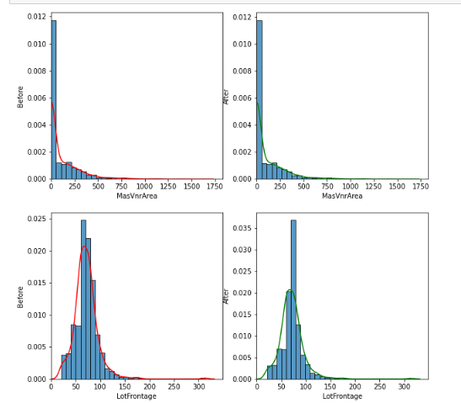
Graphs:
From this barplot we analysis that before filling NaN and after filling NaN.

Slide 8
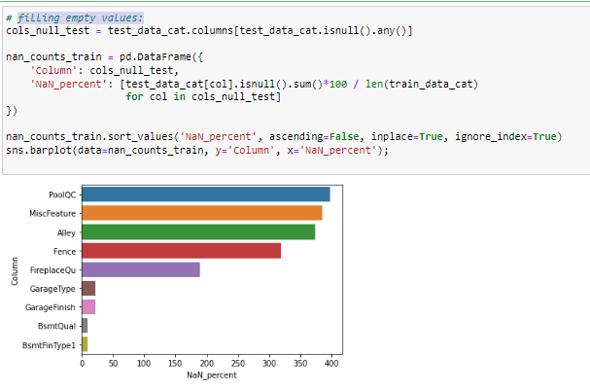
Graphs:
Here Showing filling empty values.

Slide 9
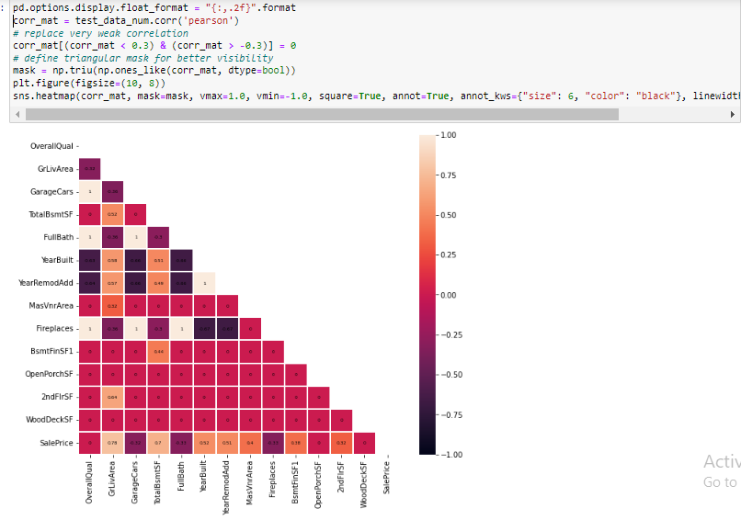
Graphs:

Slide 10
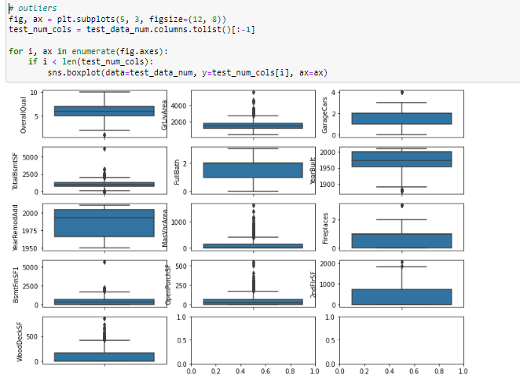
Graphs:

Slide 11
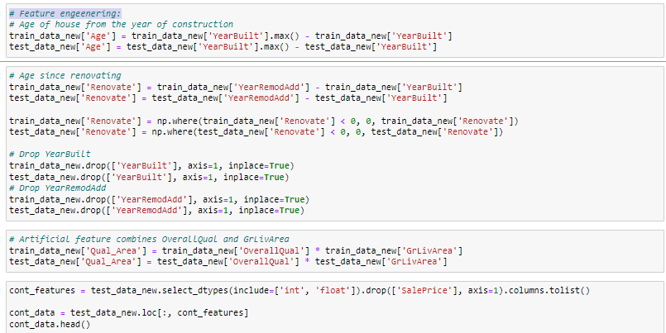
Feature engeenering:

Slide 12
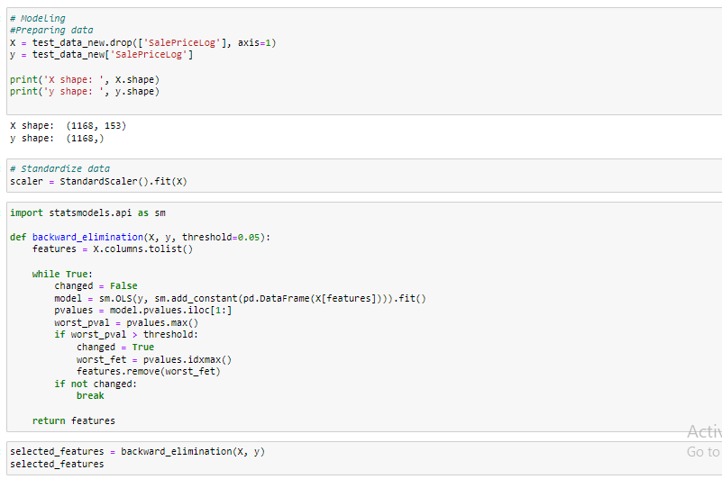
Testing of Identified Approaches (Algorithms):
.

Slide 13
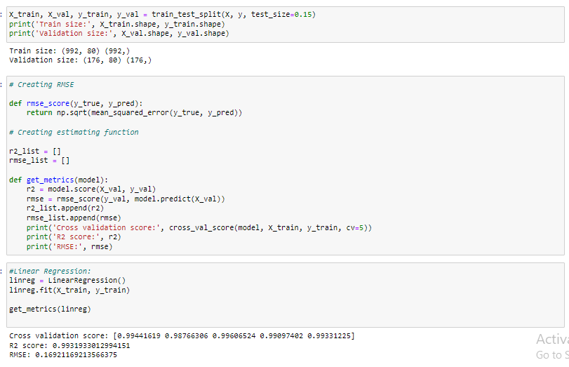
Run and Evaluate selected models:

Slide 14
Run and Evaluate selected models:

Slide 15
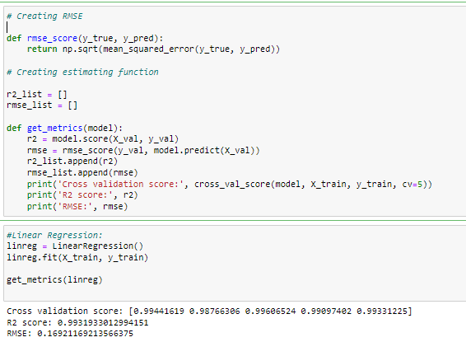
Creating RMSE:

Slide 16
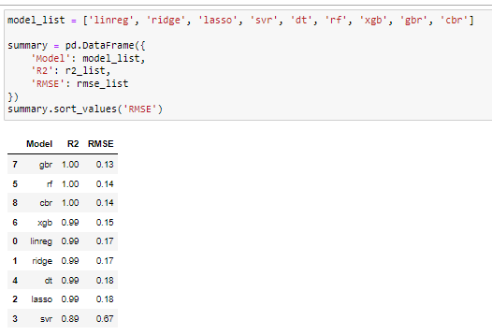
Interpretation of the Results:

Slide 17
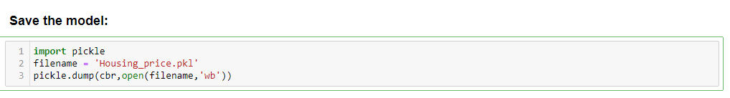
Save the Model:

Slide 18
CONCLUSION :
This Kernel investigates different models for housing price prediction. Different types of Machine Learning methods including CatBoostRegressor, GradientBoostingRegressor and LightGBM and two techniques in machine learning are compared and analysed for optimal solutions. Even though all of those methods achieved desirable results, different models have their own pros and cons.
The GradientBoostingRegressor is probably the best one and has been selected for this problem. The Bayesian Optimization method is simple but performs lot better than the three other available methods due to the generalization.
Finally, the CatBoostRegressor is the best choice when parameterization is the top priority.

